Slide 1

Insider Threat - Same problem, just getting detected more often
Tim Schnurr, CISM, CRISC
Notes:
Career in a nutshell.. I worked at the world largest Intellectual property brokerage, we even had auctions like sotheby’s.. Auction priceline.com walker digital portfolio.
Went to work at Deloitte, IP strategy, MSSP, and Insider Threat
Now helping secure HNW individuals and SMBs, but also IP advisory and Insider Threat.

Slide 2

How I got Passionate about Insider Threat
2000s
Early 2010s
Late 2010s
2020s
Hedge Fund Analyst &
Sell Side Research
Intellectual Property Valuation & Brokerage
Big 4
Large Company Cybersecurity
Small Company & HNW Individual Cybersecurity
Notes:
Career in a nutshell.. I worked at the world largest Intellectual property brokerage, we even had auctions like sotheby’s.. Auction priceline.com walker digital portfolio.
Went to work at Deloitte, IP strategy, MSSP, and Insider Threat
Now helping secure HNW individuals and SMBs, but also IP advisory and Insider Threat.

Slide 3

Bank Employee steals $50k out of the vault?
Employee takes customer list worth $40mm?
Who is more likely to be caught?
Notes:
Why isnt valuable proprietary data protected like bank reserves. Both are the most important assets which these organizations rely on?

Slide 4
External
Internal
Adversaries trying to breach and steal data, often including proprietary or sensitive data
What Can they identify and sell easily? Or force payment?
Employee involvement

Slide 5
Insider Threat
Confusing and Convoluted
Notes:
Why isnt valuable proprietary data protected like bank reserves. Both are the most important assets which these organizations rely on?

Slide 6
Negligent
Malicious
Intent
Careless actions to open risk.
Clicking on Links, Shadow IT like dropbox or personal email
Intent to monetize for personal benefit
Or sabotage
Notes:
Classifying these two in the same term is confusing as the intent is vastly different
Insiders know what data is worth competitive perspective. Outside attackers usually hit privacy data to create leverage. Insiders know who to sell it to or take it to..

Slide 7
What’s at Risk? Crown Jewels, IP (legally called Trade Secrets)
Every organization has confidential information (proprietary and private)
Custom software
Designs
SEO Ad Words
Reputation
Customer lists
Know-how
Strategy and tactics
Playbooks
Contracts
Client deliverables
Marketing materials
Budgets and finances
Notes:
What are employee taking with them and what kind of damage can they create? Every organization has trade secrets. Non-profits know which donors donate, what stories resonate. Failure data is a trade secret. You wasted time finding out what does not work. Why should your competitors not have to endure the same expense?

Slide 8
What’s at Risk? Crown Jewels or IP
UNREGULATED BY FTC, NYDFS, HIPAA, PCI, GLBA
Every organization has confidential information (proprietary and private)
Trade secrets
Designs
SEO Ad Words
Reputation
Customer lists
Know-how
Strategy and tactics
Playbooks
Contracts
Client deliverables
Marketing materials
Budgets and finances
Notes:
You won’t find any companies declaring an Insider Breach for these 12 boxes.. SEC they likely should, but not one case that I know of.

Slide 9
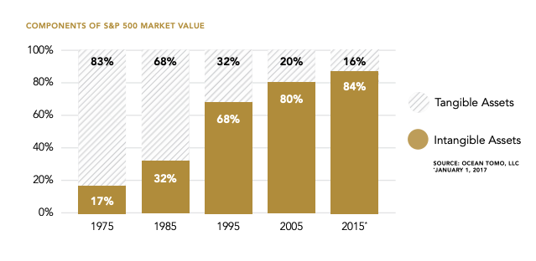
IP AS % OF COMPANY VALUE
MORE THAN 80% OF COMPANY VALUE RESIDES IN INTANGIBLE ASSETS OR IP
Notes:
Shift away from fixed assets. Exxon was the most valuable company in 2000s, “Software is Eating the World” and so IP is gaining share as % of enterprise value on average in the SP500. We are entering the data economy.

Slide 10
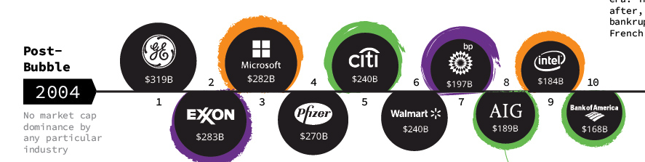
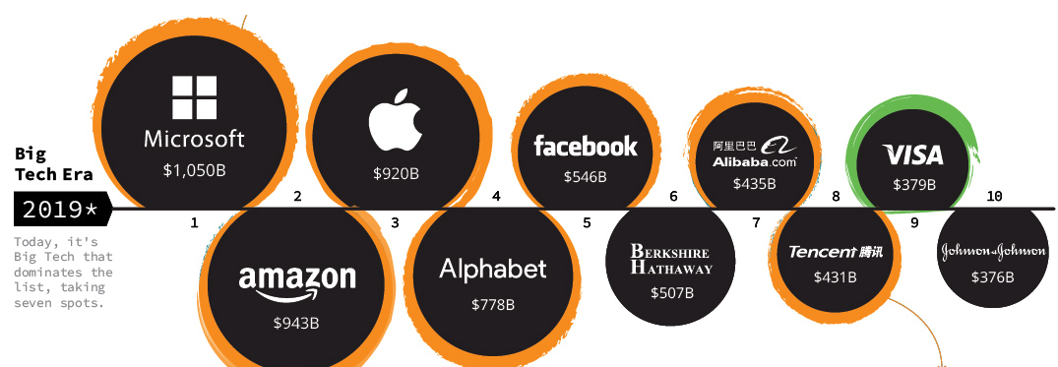
IP AS % OF COMPANY VALUE
Notes:
Software is eating the world.. Data is valuable and accessible.. Data replication and mobility is high. Code can be copied..

Slide 11
By the Numbers
60%
287
Data breaches caused by insider threat incidents ¹
Average number of days to detect and contain an insider threat ³
15M
72%
Average annual cost of an insider threat incident ²
Organizations that have experienced an insider threat in the past year ⁴
44%
Increase in insider threats over the past two years ²
¹ Cybersecurity Insiders // ² Ponemon Institute // ³ IBM // ⁴ Accenture
Notes:
One thing I learned in IP, stats on internal damage are much harder to collect as most litigation is sealed and confidential with non disclosure agreements..

Slide 12

Much Unreported
NO DUTY TO DISCLOSE INSIDER “BREACH” - EMPLOYEE EXITS WITH FILES (NOT PRIVACY DATA)
Also not Insurable!
Notes:
Employee litigation often sealed under NDA. Less loss of reputation as it never hits the press, Investors never hear about it.. Insurance by in large does not cover. Swept under the rug. Roommate from college spent a year in litigation for taking a list from a European Bank. Not in the news or reported to Verizon Breach Report.

Slide 13

In the News
Notes:
Patents you get one bite at the apple. A bunch of things have to go right.. Aleynikov, a naturalized US citizen who emigrated from the disintegrating Soviet Union in 1991, earned nearly $400,000 a year as a vice president with Goldman Sachs developing its trading software. The software allowed the company to swiftly process quickly changing market data and place automated trades based on the latest market conditions. Goldman Sachs spent millions to acquire and develop the system, which resulted in millions of dollars in trading profits each year, according to the court record.
Aleynikov worked for the company from 2007 to 2009 when he decided to take a new job with Teza Technologies that would have paid him about $1.2 million.
But days before leaving his old job, Aleynikov encrypted and downloaded files from Goldman Sachs's network that contained code he had worked on. He transferred the data to a website hosted in Germany, then erased the program from Goldman Sachs' network that he had used to encrypt the files, according to court records. He also attempted to delete the network’s bash history showing his activity, which prosecutors insisted was evidence that he knew his actions were wrong.

Slide 14

In the News
Waymo accepted a settlement offer from Uber. The on-demand car company will not incorporate Waymo's proprietary information into hardware and software. Uber agreed to a financial deal that includes 0.34% of Uber equity at a $72 billion valuation, which works out to about $245 million.
Levandowski apparently (according to Waymo) downloaded more than 14,000 “highly confidential and proprietary files” from the company before leaving. These files included Waymo’s proprietary LiDAR circuit board design, reportedly.
Waymo says it discovered this chain of events initially when a supplier accidentally copied it on emails to Uber and Otto that contained a circuit board design from the ride-sharing company which looked remarkably like its own
Notes:
While working on Google’s Street View maps in 2008, the young engineer built a self-driving Toyota Prius on his own time, using technology developed by his own startup, 510 Systems. He had been working on autonomous vehicles since 2004, when he built a driverless motorcycle for the Grand Challenge, a race for driverless vehicles organised by the Pentagon’s research arm, Darpa. “I didn’t know where this technology was going to be used or how it would work out, but I knew that it was going to change things significantly,” he recalled during an interview in 2016.
“Google was very supportive, but they absolutely did not want their name associated with a vehicle driving in San Francisco,” he said. “They were worried about an engineer building a self-driving car that kills someone and it gets back to Google.”
However, after a successful demonstration in which the driverless Prius delivered a pizza autonomously in the heart of the city, Google’s attitude thawed. Levandowski persuaded the company’s founders, Larry Page and Sergey Brin, to buy 510 Systems and bring the car into a secretive new unit of Google called X dedicated to “moonshot” projects.
Waymo’s lawsuit skips over Levandowski’s formative role altogether, stating only that “Google initiated its self-driving car project in 2009”.
Not everyone at 510 Systems was happy with the sudden change. “I regret how it was handled,” Levandowski said in the 2016 interview. “Some people didn’t make the cut … But it worked out well for most of the people involved.”
Levandowski helped develop more driverless cars for Google, quietly testing them on the streets of California before the state enacted laws requiring permits. “If people asked us what was on the cars, we’d say it’s a laser and just drive off,” he said.
The suit did not have Levandowski in it originally as he no longer worked at Uber. larry page got infuriated the more data he found and evidence of foul play.
Google had separately taken Levandowski to private arbitration over a contract dispute. On March 4, 2020, Levandowski filed for bankruptcy protection after the court confirmed an arbitration panel's ruling that Levandowski and his colleague Lior Ron had breached their employment contracts with Google by poaching employees for their startup. The panel found that Levandowski owed Google $179 million—$120 million accounted for the salary he received while at the company, and the remainder for interest and legal fees accrued. Originally Uber had agreed to indemnify.
Was about to serve 18 months in jail, when trump pardons him in january 2021..

Slide 15

Pegasystems Inc. v. Appian Corp. Appian Corp. landed an eye-popping $2 billion award from a Virginia state jury in May 2022 after suing software company Pegasystems Inc. for allegedly stealing its trade secrets.

Slide 16

As an MSP Why Do I Care?
SHH..
It’s better way
To sell Cyber!
Getting burned by ex employee is more tangible, emotional, & contextual than external hacker FUD..

Slide 17

Don’t Sell Cybersecurity
Sell Employee Assurance

Slide 18
Why Does Insider Threat Occur?
Too often employees don’t realize they don’t own the work (or book of business) they created, rather the firm does
They can’t leave or exit with it - Did not acknowledge duty to protect
Over sharing is easy and less work - Confidentiality (i.e., least trust, need to know)
Under-estimate the worth of stealing trade secrets.
Deterrents and culture don’t exist -
Additional security controls - Data Classification - Watermarks
Role-based access (RBAC) on everything
IP Awareness training
IP incentives and performance awards
Other ex-employees being sued
Notes:
Novel concept. You train employee, you pay them salary, the fruits of their labor are owned by the company. This has to be ingrained in culture. Carrots and sticks. Physiological deterrent. Bank employees dont steal from the vault, cameras, daily audits. Treat your data like a bank would treat deposits.

Slide 19
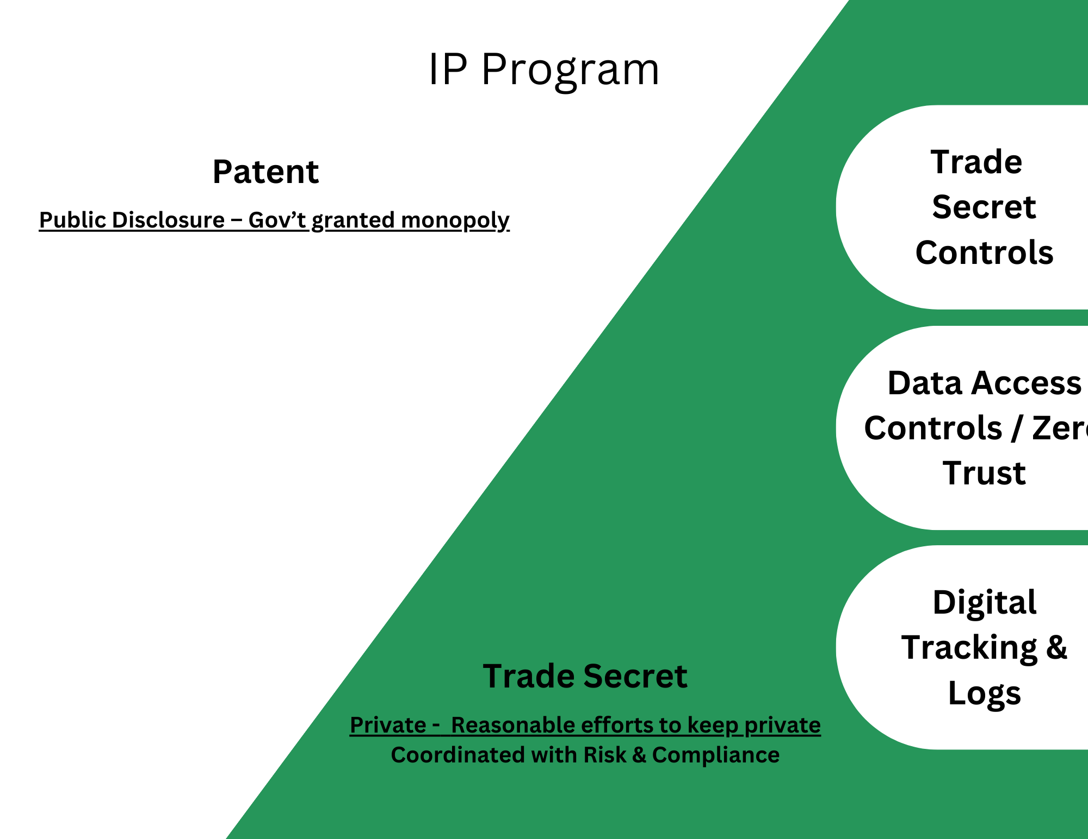
Shift in IP Strategy
Notes:
File the patent, hush hush until it gets the lawyer and patent office. Everything else was considered “open source” - Now the world is shifting to trade secret usage. I Don't want to dive down the patent rabbit hole, come grab me at cocktails.. DO NOT FILE PATENTS.. In 5 years you will thank me. Trade secrets have layers of laws to leverage for litigation (federal and state employee laws), breach of fiduciary duty, breach of contract, fraud and deceit, embezzlement, and violation of the corporate opportunity doctrine

Slide 20





Who’s Responsible?
Insider threats (specifically IP Strategy) falls somewhere between cybersecurity, human resources, IT, legal, and risk-management departments
Cybersecurity
HR
Legal
Risk
Also…
Not included in most frameworks (NIST, CIS, ISO)
Not a focus until a bad employee exit
GC may not have IP background
We are not a tech company, so not a specific worry
Small organizations likely have none of these roles
Notes:
you have lawyers at banks that handle “privacy” that also handle IP. Only Big tech does this well of building culture and department collaboration. Excessive litigation in banks, shows that the culture is not there yet.

Slide 21

SMB Does not have these departments
Cybersecurity
HR
Legal
Risk
Also…
Not included in most frameworks (NIST, CIS, ISO)
Not a focus until a bad employee exit
GC may not have IP background
We are not a tech company, so not a specific worry
Small organizations likely have none of these roles
Notes:
you have lawyers at banks that handle “privacy” that also handle IP. Only Big tech does this well of building culture and department collaboration. Excessive litigation in banks, shows that the culture is not there yet.

Slide 22
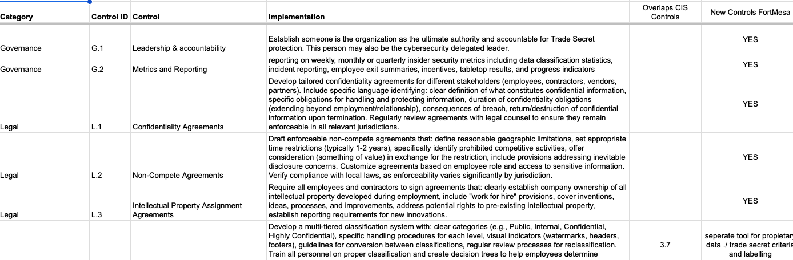
Sell Controls, Sell Employee Outcomes

Slide 23
Non-Technical Controls
Recover & Iterate
Technical Controls
Detect & Respond
Negligent Insider Defense
Cybersecurity
IP and Insider Threat Policy in contract & NDA (explicit acknowledgement)
Malicious Insider Defense
Tools: DLP, SIEM, IAM, User behavior analytics (UEBA), SOAR playbooks
Employee Handbook
Logs, analytics, and KPIs on IP creation, access, retention
Protect
Initial & periodic awareness training and testing
Identify
Zero Trust Strategy on data access
Data retention policy
Equity
Employee onboarding & offboarding IP convo
Trade Secret Catalog & Document Marking
3rd parties
Innovation Incentives
External Contractors / Joint Venture / CRATA
AI Policies
Employee Recognition & Workplace Culture

Slide 24
Overlapping Defense
Tools and Enforcement
Leadership defined goals and policy
Document Trade Secret Catalog (Meta-Data likely ideal) - IDENTIFY
Employee handbook and training (obligation confirmation) - Onboarding and Offboarding
Incorporate into Cyber Training
Enforce with Tools (Can’t depend on Whistleblowers) - PROTECT - DETECT
Data classification tools
Data access tools
Logs
Policies & Alerts
Watermarking and tracking - Stenography / chain of custody

Slide 25
Role Play Litigation
Imagine trying to convince a judge that an employee is guilty of stealing company assets. What evidence can be presented that the assets were REASONABLY protected?
What rules were conveyed?
Did the employee understood the duty and clearly violated that responsibility?
Was monitoring sufficient?
Is the evidence clear? - DEFEND TRADE SECRETS ACT 2016
Notes:
Reasonable efforts to protect

Slide 26
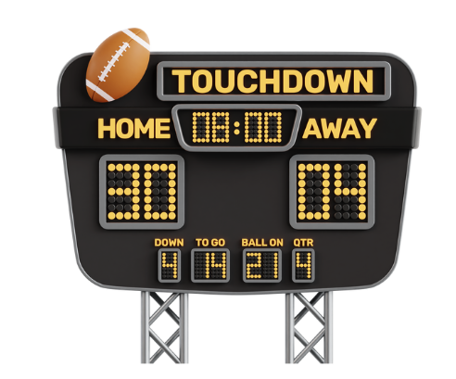
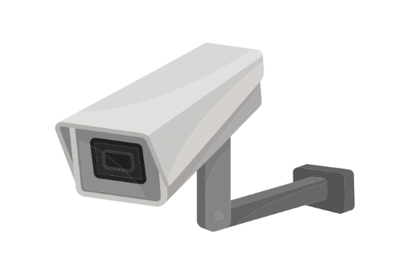
Employee Privacy Balance - Positive Motivation vs Fear
vs.
Notes:
Reasonable efforts to protect

Slide 27

Also a great way to increase your budget to senior leadership as you protect/guard firm value. Show value in risk reduction / resilience
Notes:
Reasonable efforts to protect. Talk to leadership about WHAT IFs. What if a sales guys take a list of the CRM to the next company? What if a lawyer takes a copy of his data (trials, clients, statistics on sealed settlements, evidence in cases, expert testimony reports)? What if a hedge fund employee takes all of the research and investment criteria, or scouting to a new firm? What is a teacher takes all of the curriculum from every grade? Or worse records of student performance? The list is endless. You know your clients and you know what language or use cases will trigger investment.

Slide 28
Key Takeaways

Slide 29
Software is eating the world (90% balance sheet)
IP is in the Data
Losses are Uninsurable
SMBs wont solutions, MSPs have them.

Slide 30




Non-technical Must Haves (HR & Legal)
Acknowledge duty of company ownership
Employee agreement, NDA, IP assignment
Employee Handbook and ongoing training
Onboard and Exit Procedures

Slide 31
Technical - Logs, Forensics, Alerting, Testing
(IT & Cybersecurity)
Identify and Classify Data
Access Controls
Logging
Simulate
Tools: Data Classification Tools, Watermarks, OCR, RBAC, IAM, SOAR, UEBA, SIEM, Managed Browser, DLP

Slide 32
Resources
https://www.cisa.gov/topics/physical-security/insider-threat-mitigation
https://www.tradesecretsinsider.com/wp-content/uploads/sites/323/2015/07/Reasonable-Steps.pdf
https://www.stimmel-law.com/en/articles/criminal-prosecution-theft-intellectual-property-case-study

Slide 33
Questions and Comments
Tim@leasttrust.com
DM me on LinkedIN, ANYTIME!

